Slide 1
Name Entity Extraction Using MIT Movie Corpus
PIYUSH RUMAO

Slide 2
Introduction
Task:
The key achievement of this task is to create an algorithm which will detect name entities.
Name Entity Extraction (NER) consist of designing an algorithm to extract only key pieces of information or entities and categorize them into relevant type such as Person, Location, Date, Currency or could be any TAGS as per requirement.
Dataset:
So I need to use the MIT Movie Corpus which is a semantically tagged training and test corpus in BIO format. The eng corpus are simple queries, and the trivia10k13 corpus are more complex queries. They can be found here:
https://groups.csail.mit.edu/sls/downloads/movie/
So I will use the trivia10k13 corpus to create an algorithm to detect Entities.
Labels:
The key labels of our interest are: ['I-Plot', 'I-Year', 'I-Character_Name', 'B-Actor', 'B-Soundtrack', 'B-Plot', 'I-Quote', 'I-Award', 'I-Opinion', 'B-Quote', 'B-Character_Name', 'I-Relationship', 'I-Actor', 'O', 'B-Relationship', 'I-Genre', 'B-Opinion', 'I-Soundtrack', 'B-Director', 'B-Genre', 'B-Origin', 'B-Year', 'I-Director', 'B-Award', 'I-Origin']

Slide 3
Approach
Build own model for Fine Tuning BERT using transformer library
Use Simple Transformer package which is a wrapper on top of Huggingface

Slide 4
Outline and Steps
Prepare the sentences and labels
Tokenize words using BERT pretrained tokenizer and convert them into ids
Set max sentence length
Add padding to both sentence ids and labels to equal max sentence length
Create attention mask from input sentence to ignore padding
Split data into train and validation
Set model hyper-parameters like learning rate, #epochs, batch size etc
Fine tune Pretrained model on train data and evaluate loss per epoch on validation data
Apply model on unseen test data and evaluate on performance metrics like accuracy, f1 measure, confusion matrix and classification report

Slide 5
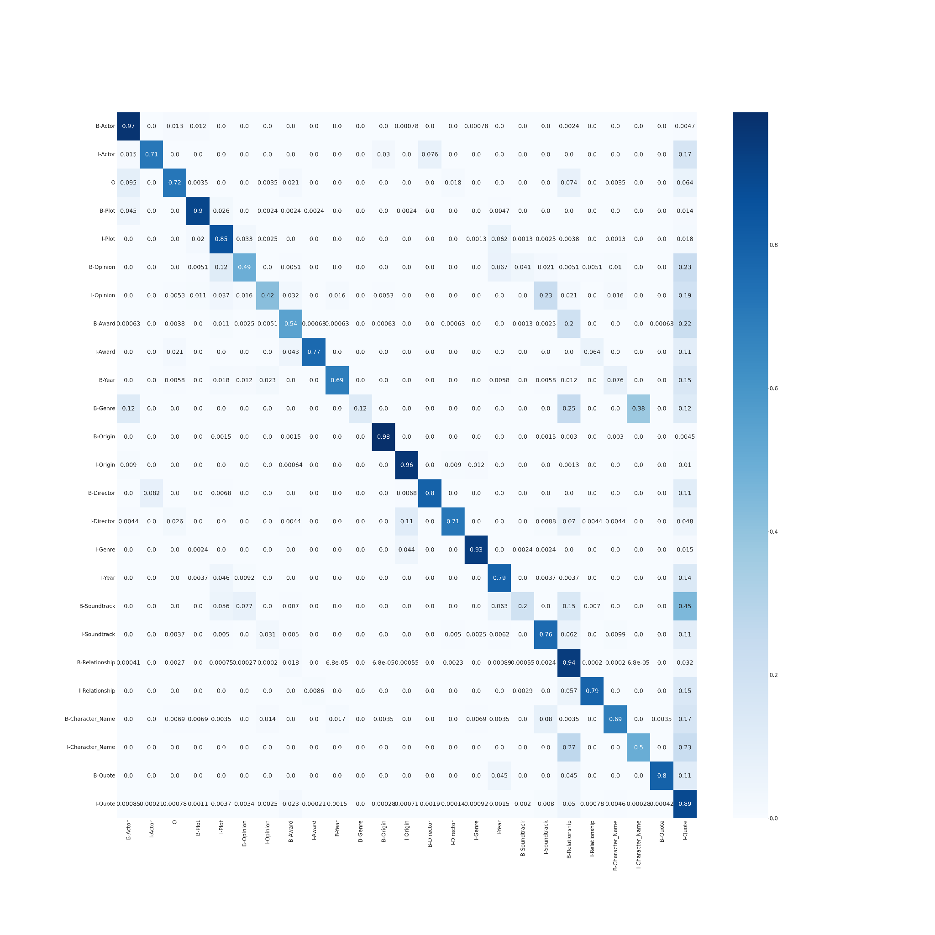
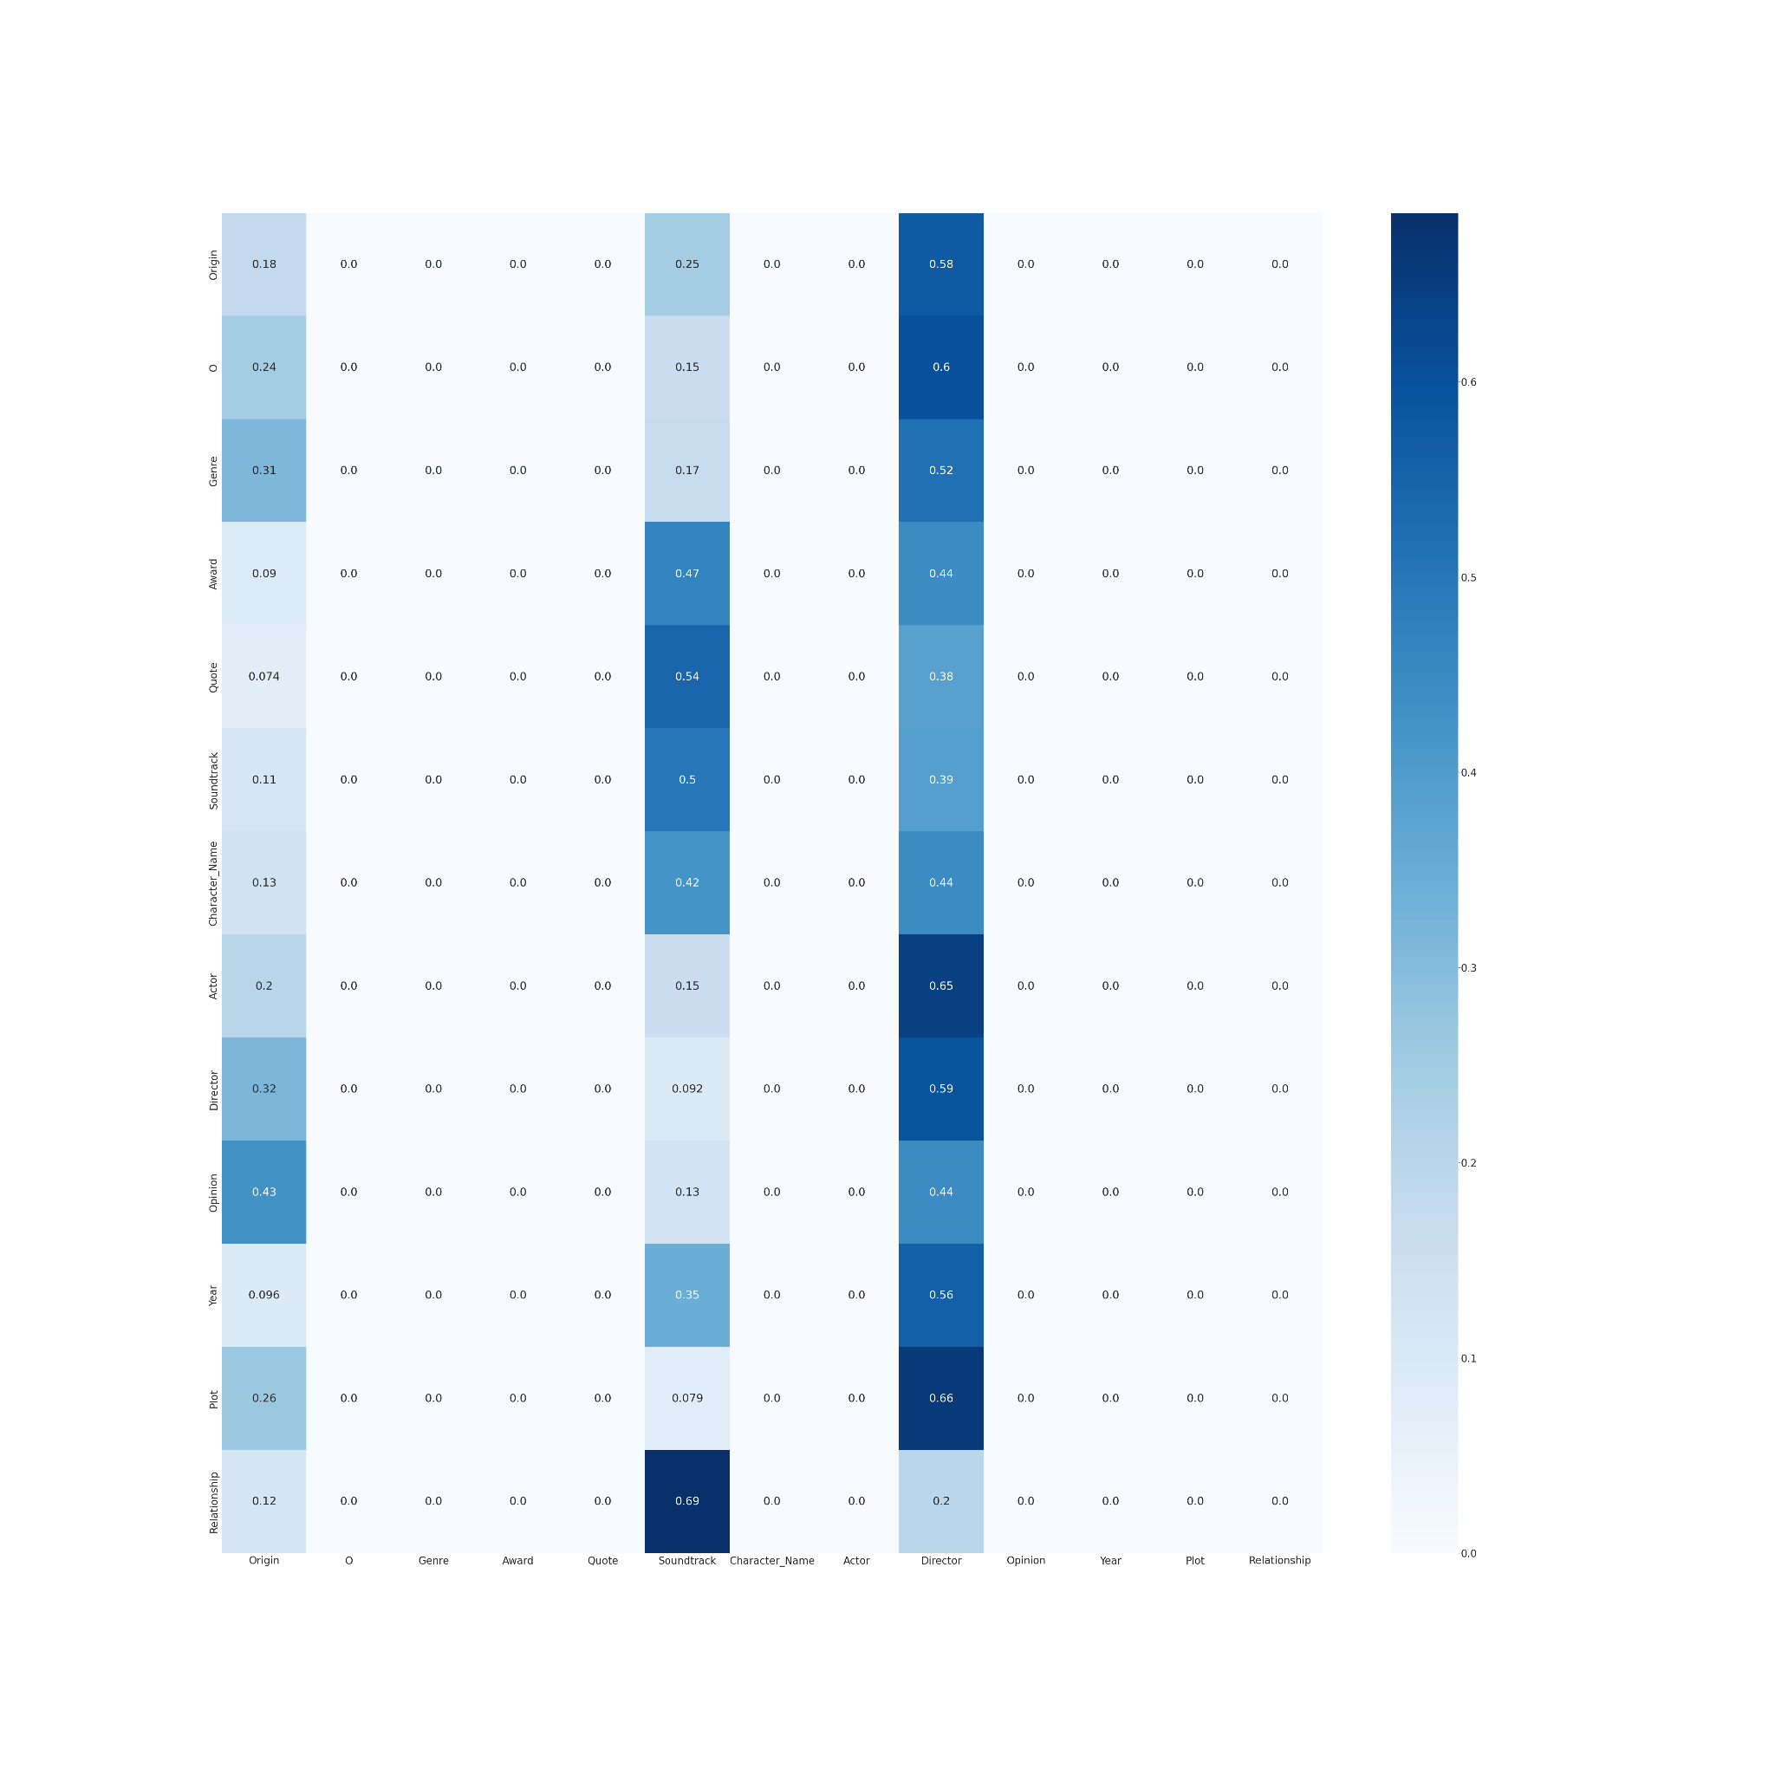
Performance Metrics

Slide 6
Performance Metrics
The slide above showed a glimpse of how custom model performed in comparison to one trained using Simple transformer using heat map
So simple transformer trained the model very well and performed excellent in distinguishing each class.
Kindly check classification report and confusion matrix of both in output_matrix directory
The best score which I could get was {'eval_loss': 0.37423170418027907, 'precision': 0.6742969260954872, 'recall': 0.7252901864227929, 'f1_score': 0.6988645992204712} on test data

Slide 7
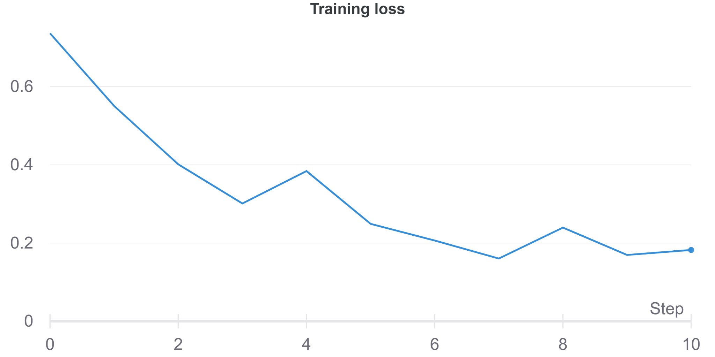
Performance Evaluation
Training loss of Simple transformer

Slide 8
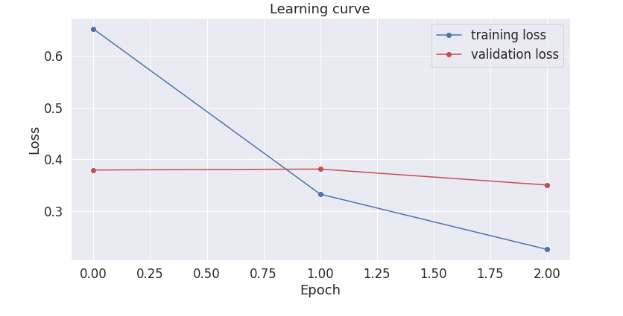
Performance Evaluation
Training loss vs Validation loss of custom model

Slide 9
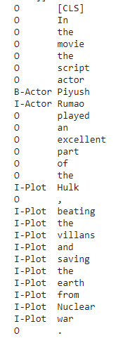
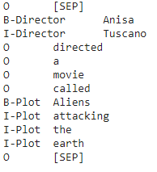
Performance Evaluation
Model Prediction on User given sample sentences

Slide 10
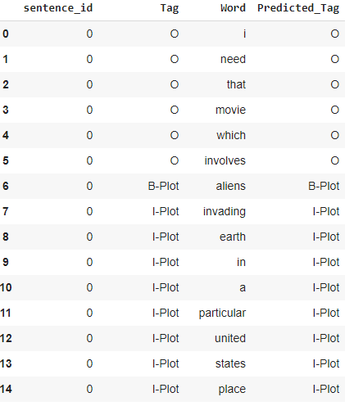
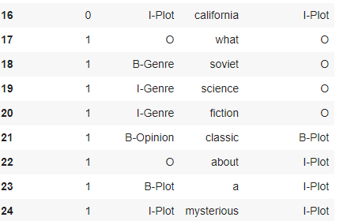
Performance Evaluation
Test data where model performed well and where model misclassified
Correctly Classified Incorrectly Classified

Slide 11
Lessons Learnt and Potential Improvements
1. NER classification is a token based classification where I had to represent every word with its equivalent label and there is high chance of making some kind of mistake if designing own algorithm like data preprocessing or in training unlike other classification which are more straightforward.
2. The way BERT tokenize words is unique, it uses wordpiece tokenization instead of whole word.
For example: If I tokenize the sentence "Steve mcqueen provided a thrilling..."
Bert will break it down like this ['s', '##te', '##ve', 'm', '##c', '##que', '##en', 'provided', 'a', 'thrill', '##ing',..]
giving you a list of word pieces which are longer and can be prone to error, also if a sentence is too complex it will be broken into multiple sentences for crossing max sentence limit which can cause failure for model to learn well.

Slide 12
Lessons Learnt and Potential Improvements
3. I started with just 1 epoch and then went on till 5 epochs and by increasing number of epochs the model got better and better at prediction.
4. Certain hyper-parameters like learning rate, does play a key role and having too low/high learning rate like 3e-5 with just 3 epoch's for fine tuning didn't give me a great model, but increasing the learning rate slight 3e-4 did give me good results.
5. I used the BERT cased model as my base model, before fine tuning it with custom data and tags, however I believe having sufficient data on Cased tags is something we need to investigate on, if my custom data has little cased tokens then model won't generalize well. For instance, my data had B-Quote 126, B-Soundtrack 50 data entries in training and all might not be Upper or lower case and it would be unfair on model if it didn't pick that up in test.

Slide 13
Lessons Learnt and Potential Improvements
6. After splitting train-validation data I tried random shuffler for training data and my model performed very poorly with it.
7. Even the performance evaluation type plays a key in scoring the model,
Our task includes (B- I-) tags showing its beginning or includes and there is case where model misclassified those but correctly classified the parent tag.
so is our evaluation strict or relaxed on prefix of label also matters.

Slide 14
Learning Resources
Research Papers
Attention Is All You Need
BERT: Pre-training of Deep Bidirectional Transformers for Language Understanding
BERT Explained
The Illustrated Transformer
Learning Materials, Packages and documentation
Hugging Face - The AI community building the future
Simple Transformers - Using Transformer models has never been simpler!
Named entity recognition with Bert

